Slide 1
The lecture 3
Database objects

Slide 2
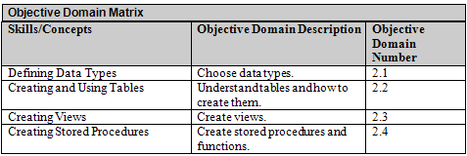
Objectives

Slide 3
Data Types
A data type is an attribute that specifies the type of data that an object can hold and it also specifies how many bytes each data type takes up.
SQL Server 2008’s built-in data types are organized by these general categories:
  Exact Numbers
  Approximate Numbers
  Date and Time
  Character Strings
  Unicode Character Strings
  Binary Strings
  Other Data Types
  CLR Data Types
  Spatial Data Types

Slide 4
Data Types
Money (Numeric) - This numeric data type is used in places where you want money or currency.
Datetime - The datetime date and time data type is used to store date and time data in many different formats
Integer - The int numeric data type is used to store mathematical computations and is used when you do not require a decimal point output.

Slide 5
Data Types
Varchar - This character string data type is commonly used in databases where you are supporting English attributes
  nvarchar – Used for non-English languages
Boolean - Otherwise known as a bit data type.
Float - This numeric data type is commonly used in the scientific community and is considered an approximate-number data type.

Slide 6
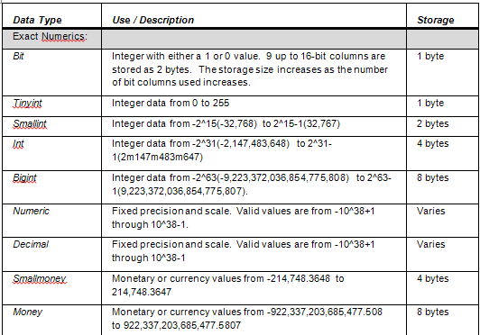
Data Types

Slide 7
Implicit and Explicit Conversions
SQL Server supports implicit conversions, which can occur without specifying the actual callout function (cast or convert).
Explicit conversions actually require you to use the functions cast or convert specifically.

Slide 8
Views
A view is simply a virtual table consisting of different columns from one or more tables.
Unlike a table, a view is stored in the database as a query object; therefore, a view is an object that obtains its data from one or more tables.

Slide 9
Stored Procedures
A stored procedure is a previously written SQL statement which has been “stored” or saved into the database.
One of the things that will save you time when running the same query over and over again is to create a stored procedure, which you can then execute from within the database’s command environment.

Slide 10
SQL Injections
A SQL injection is an attack in which malicious code is inserted into strings which are later passed on to instances of SQL Server waiting for parsing and execution.
Any procedure which constructs SQL statements should be reviewed continually for injection vulnerabilities because SQL Server will execute all syntactically valid queries from any source.

Slide 11
Summary
A data type is an attribute that specifies the type of data that an object can hold and it also specifies how many bytes each data type takes up.
As a general rule, if you have two data types that are similar but only differ in how many bytes each data type uses, it has a larger range of values and/or has increased precision.
SQL Server includes a wide range of pre-defined data types called built-in data types. Most databases that you create or use only need to use these datatypes.

Slide 12
Summary
Exact numeric data types are the most common SQL Server data types used to store numeric information.
int is the primary integer (whole number) data type.
Precision (p) is the maximum total number of decimal digits which could be stored, both to the left and to the right of the decimal point; this value must be a minimum of 1 and a maximum of 38. The default precision number is 18.

Slide 13
Summary
money and smallmoney are Transact-SQL data types you would use to represent monetary or currency values. Both data types are accurate to 10,000th of the monetary units which they represent.
Approximate numeric data types are not as commonly used as other SQL Server data types. If you need more precision (more decimal places) than what is available in the exact numeric data type, you need to use float or real. These data types typically take additional bytes of storage.

Slide 14
Summary
The date and time data types, of course, deal with dates and time. These data types include date, datetime2, datetime, datetimeoffset, smalldatetime and time.
SQL Server supports implicit conversions, which can occur without specifying the actual callout function (cast or convert). Explicit conversions actually require you to use the functions cast or convert specifically.

Slide 15
Summary
A regular character uses one byte of storage for each character, which allows you to define one of 256 (8 bits are in a byte and 2^8=256) possible characters which accommodate English and some European languages.
A Unicode character uses two bytes of storage per character so that you can represent one of 65,536 (16 bits are in a 2 bytes and 2^16=65,536 characters). The additional character allows it to store characters from just about any language.

Slide 16
Summary
When you use a VAR element, SQL Server will preserve space in the row it resides based on the column’s defined size and not on the actual number of characters found in the character string itself.
The Unicode character strings nchar and nvarchar can either be fixed or variable like their regular character strings; they use the UNICODE UCS-2 character set.

Slide 17
Summary
The entire purpose of a table is to provide structure for storing data within a relational database.
A view is simply a virtual table consisting of different columns from one or more tables. Unlike a table, a view is stored in the database as a query object; therefore, a view is an object that obtains its data from one or more tables.
A stored procedure is a previously written SQL statement which has been “stored” or saved into the database.

